Slide 1

Action recognition using convolution neural network
0856733 Ming-Han Huang / 0856727 Kuan-Chun Hong
Advising Professor: Chuen-Tsai Sun

Slide 2
Outline
Introduction
Problem Statement
Proposed Solution
Experiment
Conclusion
Demo

Slide 3
Outline
Introduction
Problem Statement
Proposed Solution
Experiment
Conclusion
Demo

Slide 4
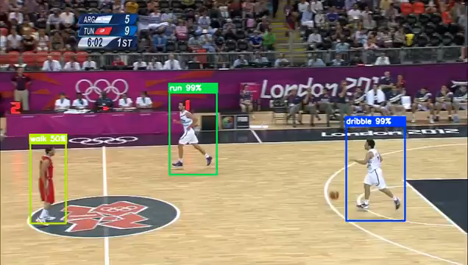
Spatio-Temporal Action Localization

Slide 5
Outline
Introduction
Problem Statement
Proposed Solution
Experiment
Conclusion
Demo

Slide 6
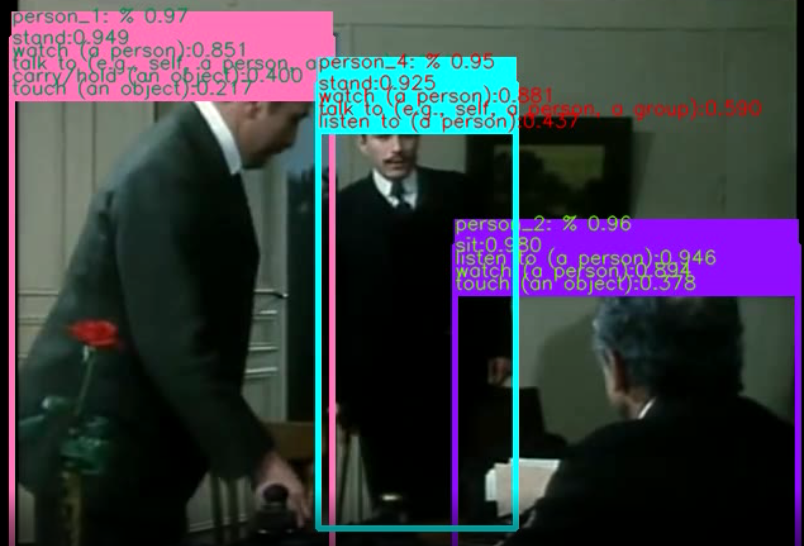
Problem Statement
Object
Detection
Action
Recognition

Slide 7
Outline
Introduction
Problem Statement
Proposed Solution
Experiment
Conclusion
Demo

Slide 8

Proposed Solution
Input Video
I3D Backbone Network
Feature Map
I3D
head
ACAM
I3D
tail
Actions
Stand 90%
Listen to 70%
YOLOv4

Slide 9
Outline
Introduction
Problem Statement
Proposed Solution
Experiment
Conclusion
Demo

Slide 10
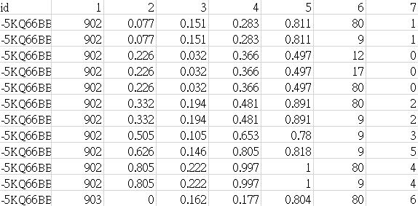
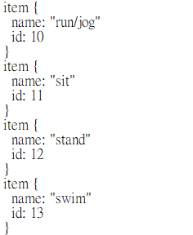
Dataset
AVA-Kinetics Dataset
430 videos from AVA v2.2, together with 238k videos from the Kinetics-700 dataset
Each video has 15 minutes annotated in 1 second intervals
60 classes

Slide 11
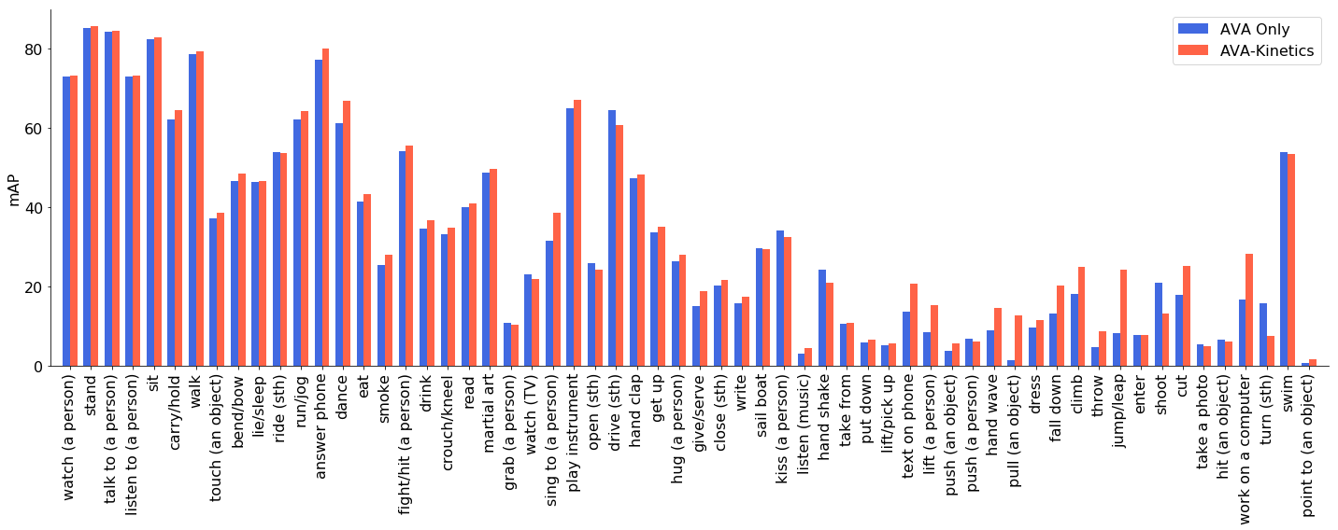
Experiment
24.15mAP (AVA-Kinetics train) / 22.29mAP (AVA only train)

Slide 12
Experiment
model | val mAP
I3D | 15.6
ACRN | 17.4
YH Technologies | 19.4
Megvii/Tsinghua | 20.01
Deep Mind | 21.9
Ours(AVA-only) | 22.29
RTPR | 22.3
Ours(AVA-Kinetics) | 24.15

Slide 13
Experiment
Failure Case

Slide 14
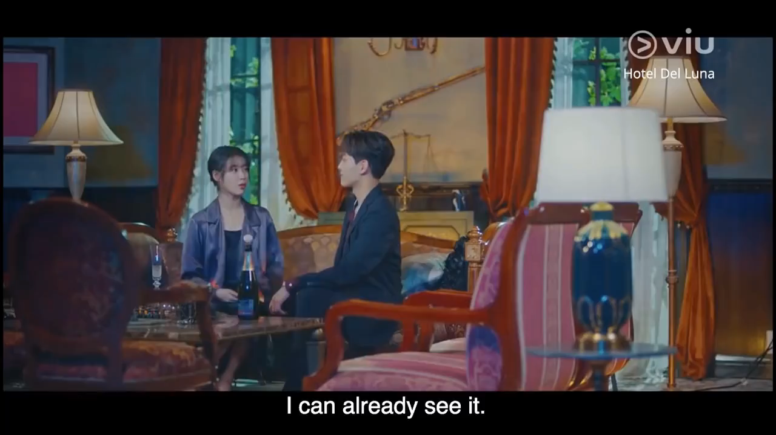
Experiment

Slide 15
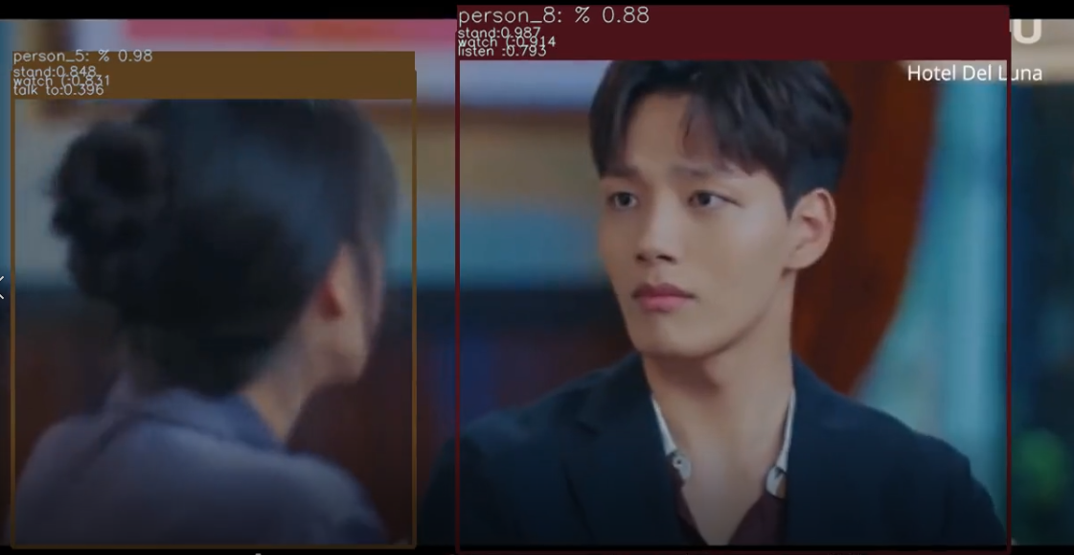
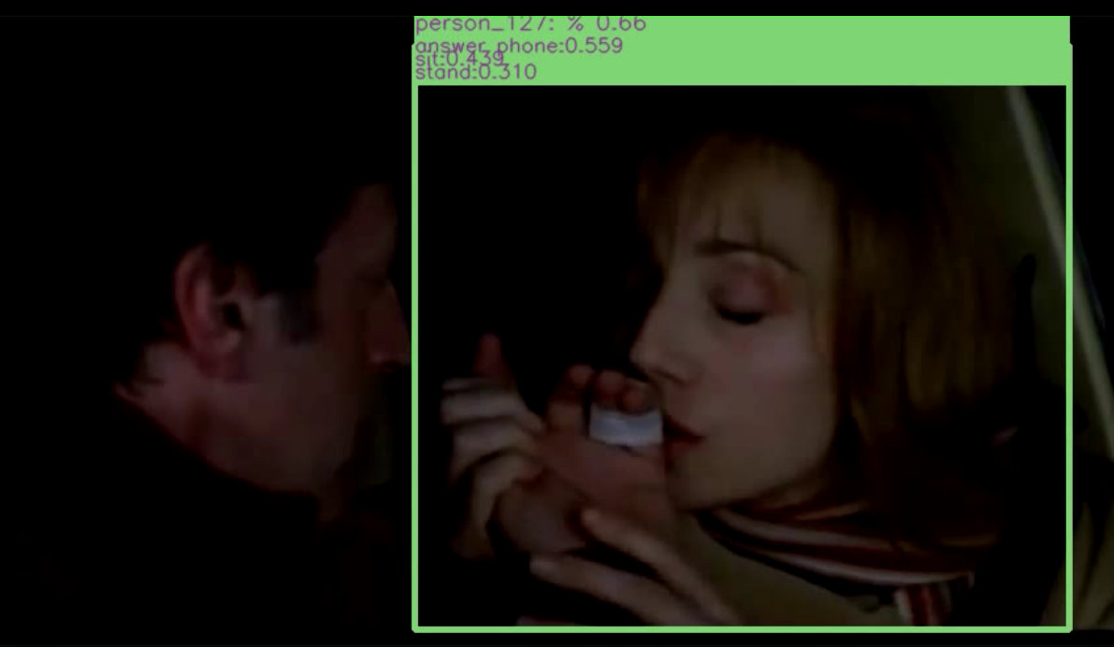
Experiment
Failure Case
GT: sit, listen to, watch
Prediction: stand, listen to, watch
GT: hold, kiss
Prediction: answer phone
Detection Missed

Slide 16
Outline
Introduction
Problem Statement
Proposed Solution
Experiment
Conclusion
Demo

Slide 17
Conclusion
Integrated yolov4 and I3D backbone to accomplish a spatio-temporal action localization task
End-to-end pipeline for real-time video action detection on videos
Trained on Kinect-700 to get better performance

Slide 18
Outline
Introduction
Problem Statement
Proposed Solution
Experiment
Conclusion
Demo

Slide 19
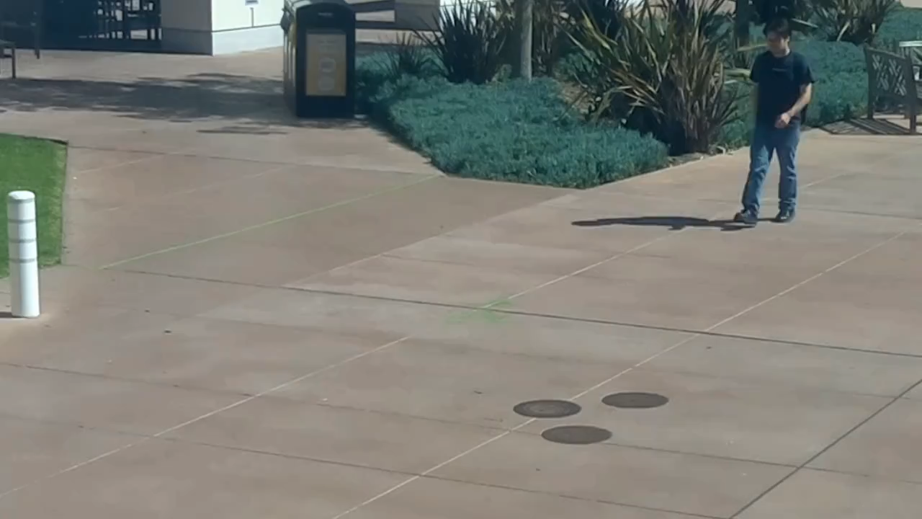
Demo

Slide 21
Reference
A. Bochkovskiy, C.Y. Wang, and H. Liao, “Yolov4: Optimal speed and accuracy of object detection,” ArXiv, vol. abs/2004.10934, 2020.
C. Gu, C. Sun, D. A. Ross, C. Vondrick, C. Pantofaru, Y. Li, S. Vijayanarasimhan, G. Toderici, S. Ricco, R. Sukthankar, et al. Ava: A video dataset of spatio-temporally localized atomic visual actions. In IEEE Conference on Computer Vision and Pattern Recognition, CVPR, 2018
C. Sun, A. Shrivastava, C. Vondrick, K. Murphy, R. Sukthankar, and C. Schmid. Actor-centric relation network. arXiv preprint arXiv:1807.10982, 2018.
Feichtenhofer, C.; Fan, H.; Malik, J.; He, K. SlowFast Networks for Video Recognition. arXiv 2018, arXiv:1812.03982
Junting Pan, Siyu Chen, Zheng Shou, Jing Shao, Hongsheng Li. "Actor-Context-Actor Relation Network for Spatio-Temporal Action Localization." Arxiv 2020.
Oytun Ulutan, Swati Rallapalli, Mudhakar Srivatsa, and BS Manjunath. 2018. Actor Conditioned Attention Maps for Video Action Detection. arXiv preprint arXiv:1812.11631 (2018).

Slide 22
Q&A

